Slide 1

Week3:
Basis of Deep Learning & classification
Machine Learning Using Tensorflow
Shu-Ting Pi, PhD
UC Davis

Slide 2
Tensorboard

Slide 3
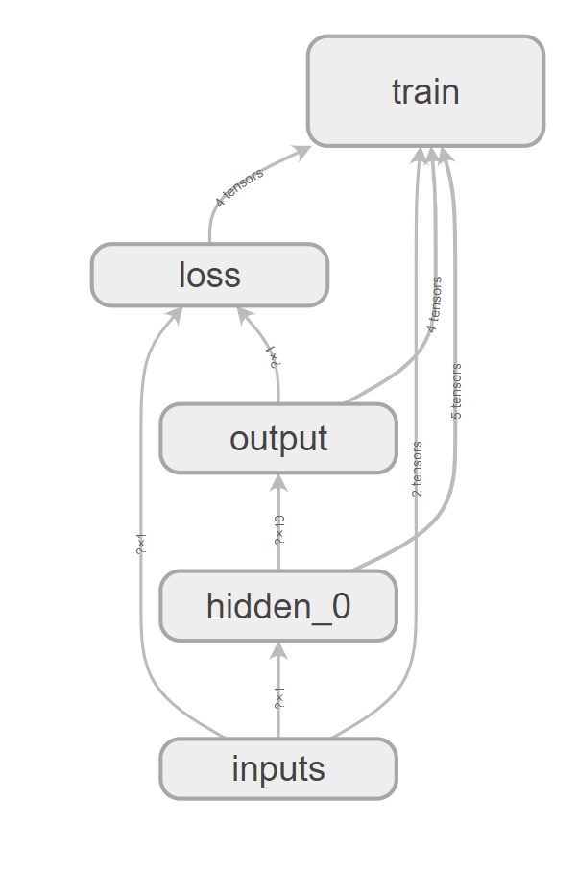
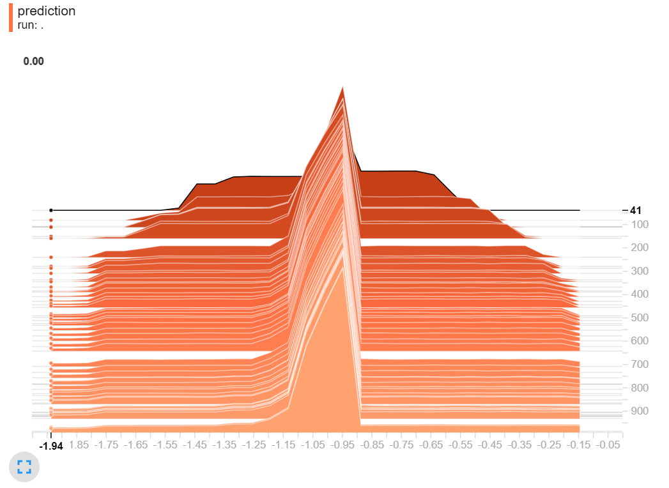
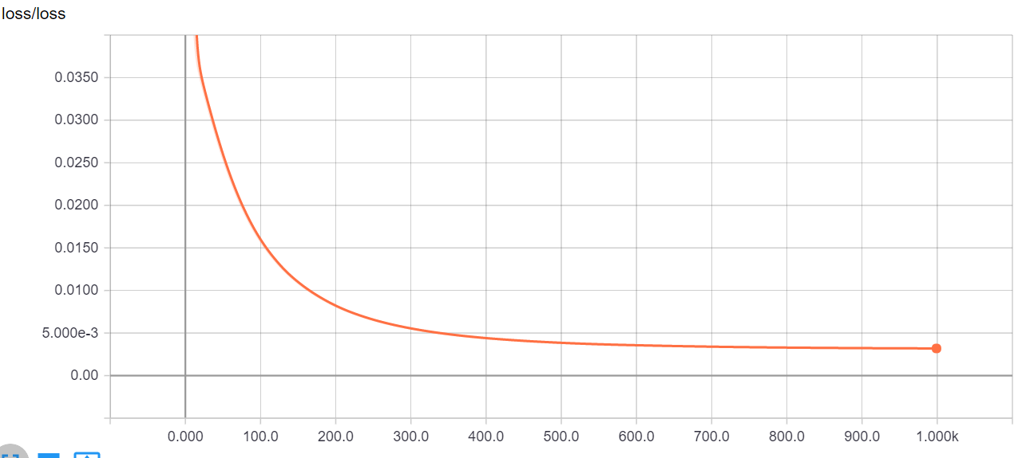
Visualization using Tensorboard
Machine Learning using Tensorflow
Shu-Ting Pi

Slide 4
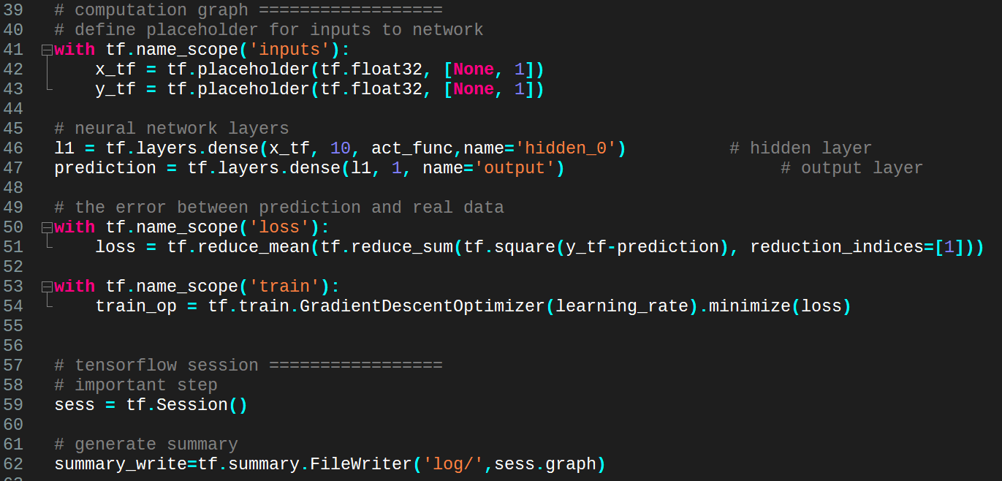
Visualization using Tensorboard
Machine Learning using Tensorflow
Shu-Ting Pi

Slide 5
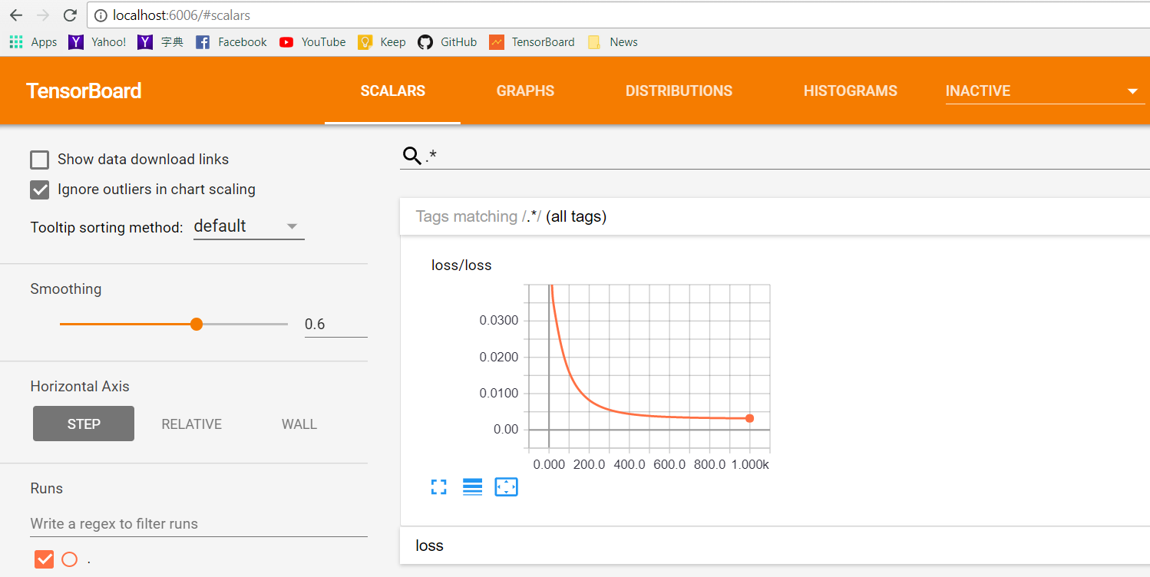
Visualization using Tensorboard
http://localhost:6006
Machine Learning using Tensorflow
Shu-Ting Pi

Slide 6
categorize

Slide 7
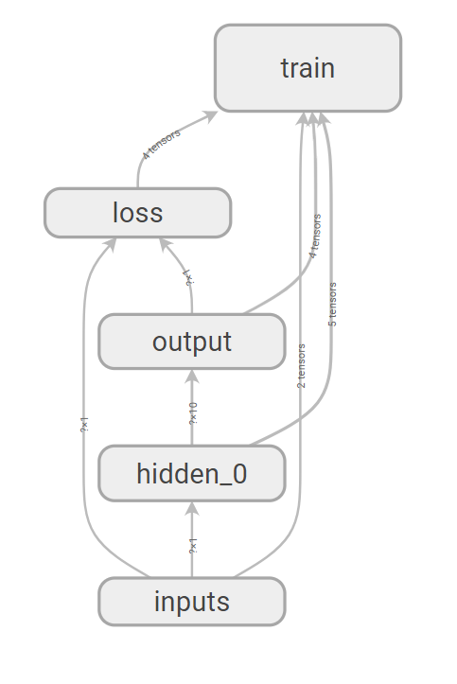



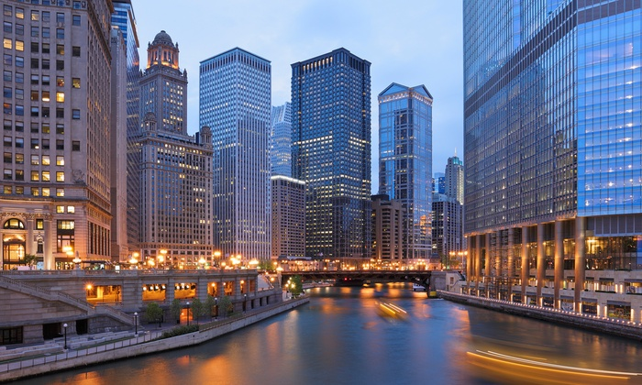
How to categorize data?
Example:
  Input (X) : hosing price, years,...etc.
  Target (Y): identify the city of the house's location
Question:
  How to “output” a label ?
  How to define the “loss” bwtween two label?
  How to “optimize” the parameters to generate a label?
Los Angel
San Francisco
New York
Chicago
Machine Learning using Tensorflow
Shu-Ting Pi

Slide 8
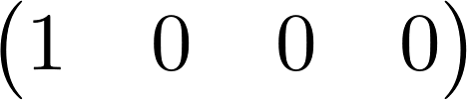
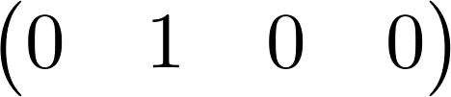
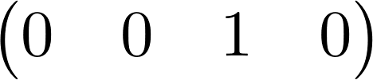
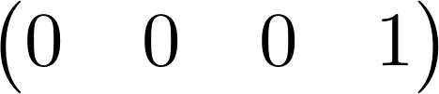
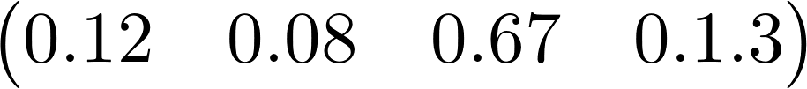
One hot representation
“Probabilize” your data !
New York →
Los Angel →
San Francisco →
Chicago →
Question:
1. How to “Probabilize” your output? (softmax !)
2. How to measure the difference between two probability distribution? (cross entropy !)
Machine Learning using Tensorflow
Shu-Ting Pi

Slide 9
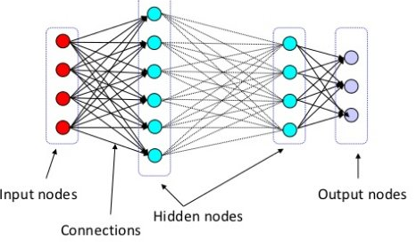

Softmax function
S
O
F
T
M
A
X
Max
Machine Learning using Tensorflow
Shu-Ting Pi

Slide 10
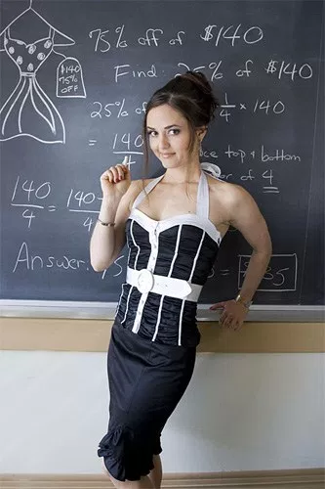
Shannon Game
Let's play a game:
1. There are many balls with four different colors in a box.
2. I will pick one from the box.
3. You ask a question and I will tell you “yes” or “no” (binary)
1
2
3
4
Machine Learning using Tensorflow
Shu-Ting Pi

Slide 11
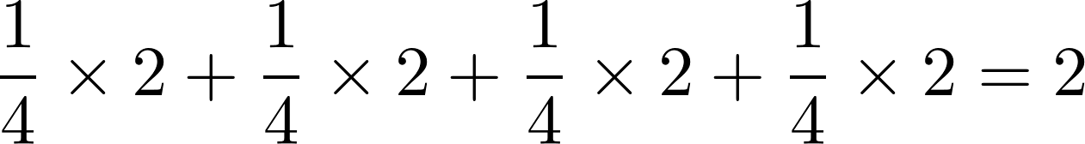
Shannon Game
Know Information:
No information about the population of colors
Best Strategy :
1 or 2 ?
Y
N
1?
3?
Y
N
Y
N
1
2
3
4
Average trials:
Machine Learning using Tensorflow
Shu-Ting Pi

Slide 12
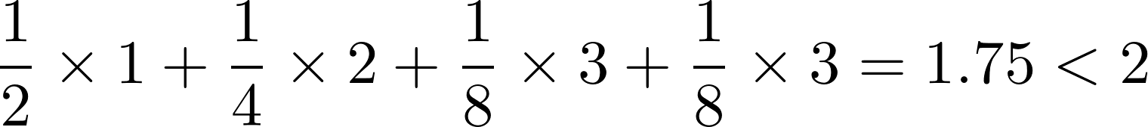
Shannon Game
Know Information:
Green: 1/2, Yellow: 1/4, Purple: 1/8, Red: 1/8
Best Strategy :
1?
N
Y
2?
N
1
Y
3?
N
2
Y
4
3
Average trials:
Machine Learning using Tensorflow
Shu-Ting Pi

Slide 13
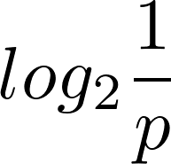
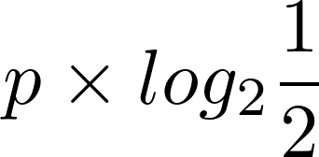
Shannon Game
Know Information:
All balls are red
Best Strategy :
No guess needed ! Average Trial=0
For probability p, we need to guess:
The average total trials:
Information Entropy
Meaning:
1. A measurement of the “uncertainty”
2. Always positive or zero (zero = no uncertainty)
3. The penalty if you want to eliminate uncertainty
Machine Learning using Tensorflow
Shu-Ting Pi

Slide 14
Shannon Entropy
For probability p, you need to guess:
Average trials:
Information Entropy
Meaning:
1. A measurement of the “uncertainty”
2. Always positive or zero (zero = no uncertainty)
3. The penalty if you want to eliminate uncertainty
Machine Learning using Tensorflow
Shu-Ting Pi

Slide 15
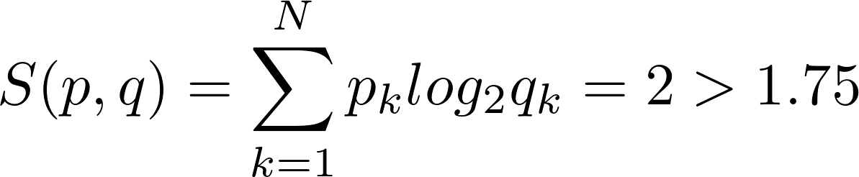
What if we choose a bad strategy
Know Information:
Green: 1/2, Yellow: 1/4, Purple: 1/8, Red: 1/8
1 or 2 ?
1?
Best
Bad
N
Y
N
Y
2?
N
1?
3?
1
Y
3?
N
2
Y
N
Y
N
Y
4
3
1
2
3
4
True probability is p, but we choose q (use q to represent p):
Cross entropy
Relative entropy , KL divergence
Machine Learning using Tensorflow
Shu-Ting Pi

Slide 16
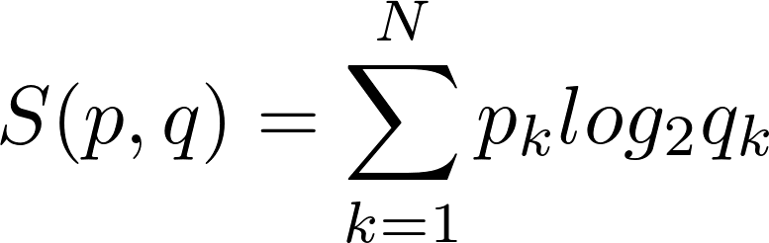
Tensorflow Graph
S
O
F
T
M
A
X
loss
Train
Cross entropy
Machine Learning using Tensorflow
Shu-Ting Pi

Slide 17
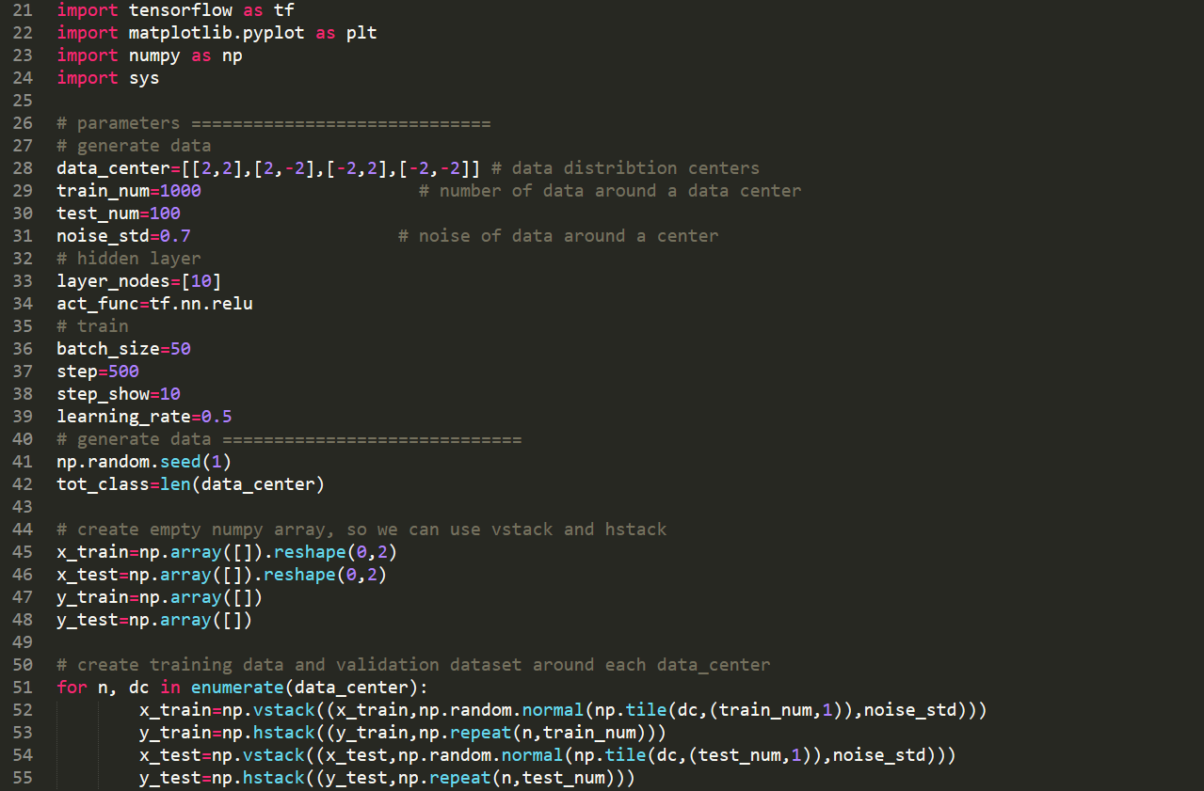
Exercise
Machine Learning using Tensorflow
Shu-Ting Pi

Slide 18
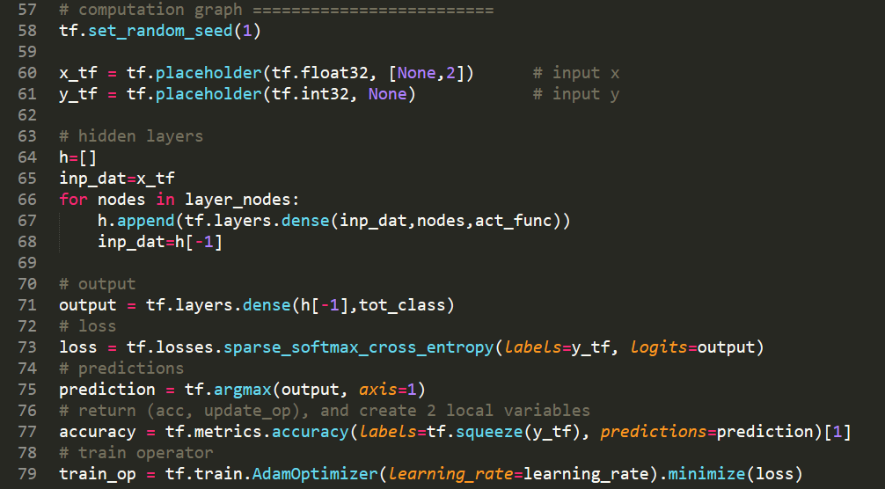
Exercise
Machine Learning using Tensorflow
Shu-Ting Pi

Slide 19
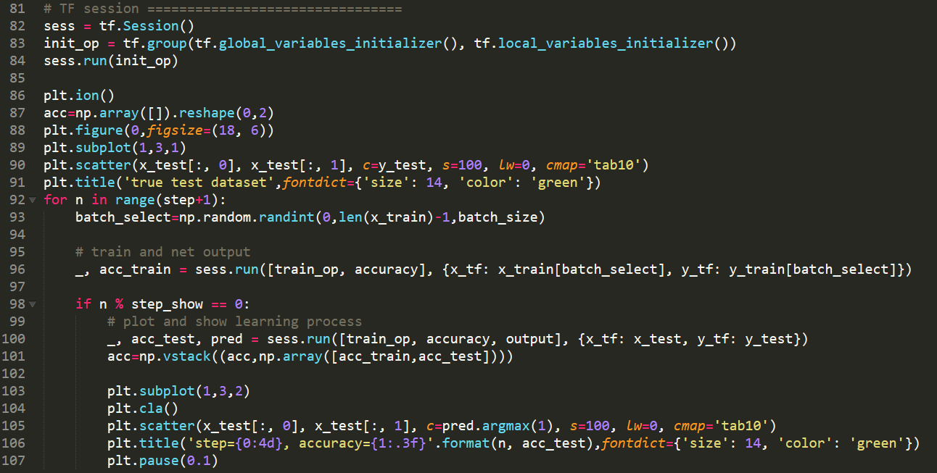
Exercise
Machine Learning using Tensorflow
Shu-Ting Pi

